Slide 1
Channel estimate
1조

Slide 2
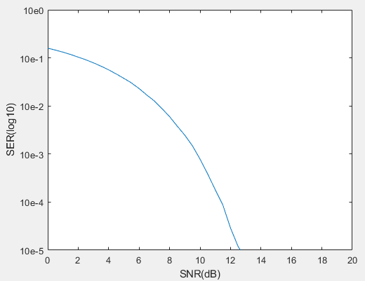
BPSK
Only Noise
13.5dB이후 error갯수 0

Slide 3
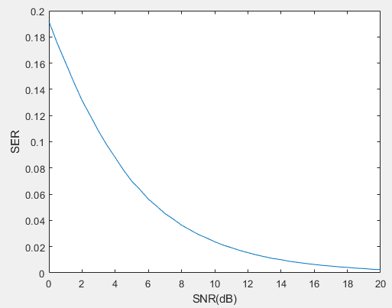
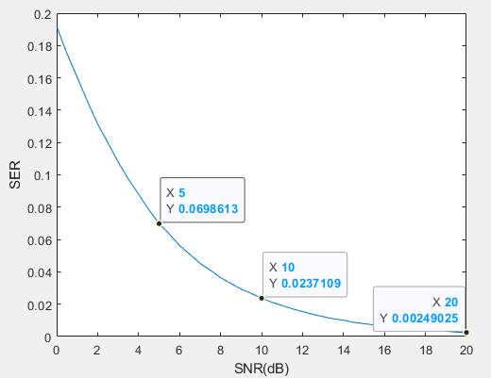
BPSK
Simulated Channel

Slide 4
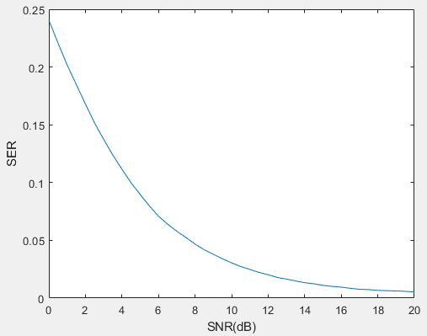
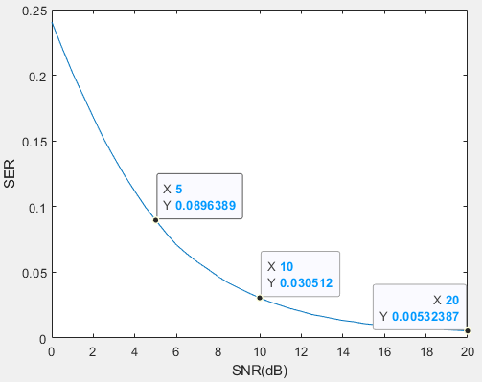
BPSK
Estimated Channel magnitude

Slide 5
BPSK
simulated vs estimated

Slide 6
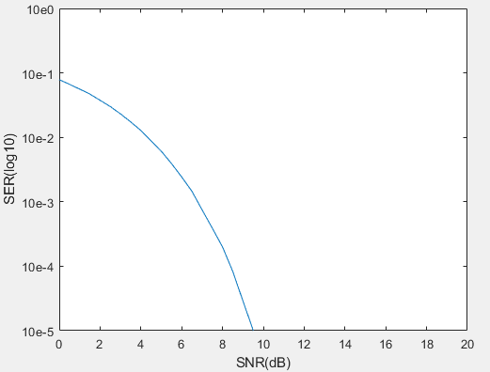
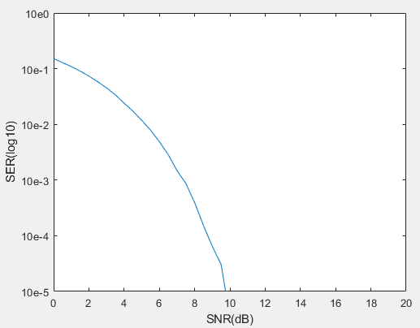
QPSK
Only Noise - BER
Only Noise - SER

Slide 7
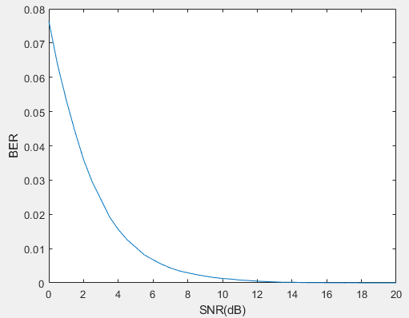
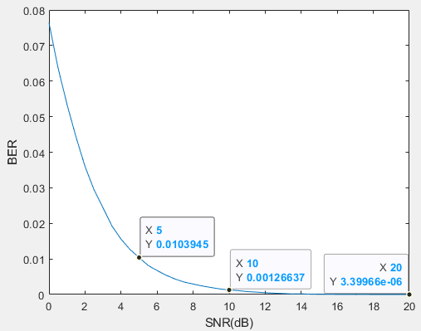
QPSK
Simulated Channel - BER

Slide 8
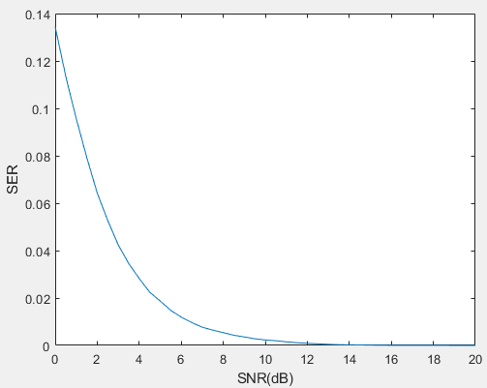
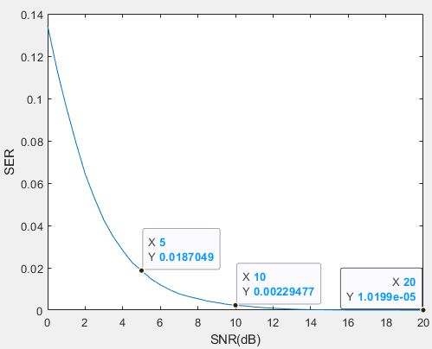
QPSK
Simulated Channel - SER

Slide 9
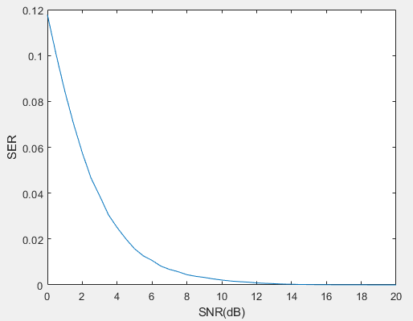
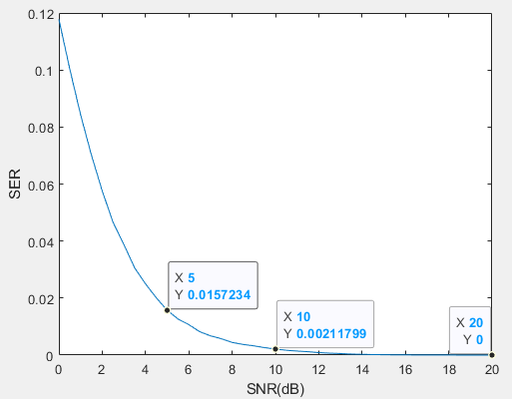
QPSK
Estimated Channel magnitude - BER

Slide 10
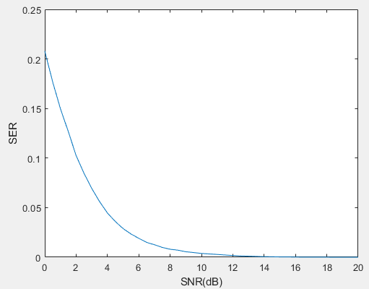
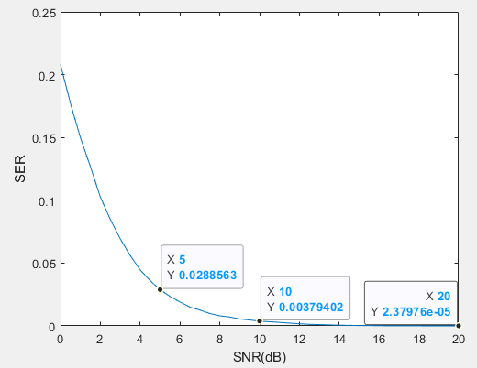
QPSK
Estimated Channel magnitude - SER

Slide 11
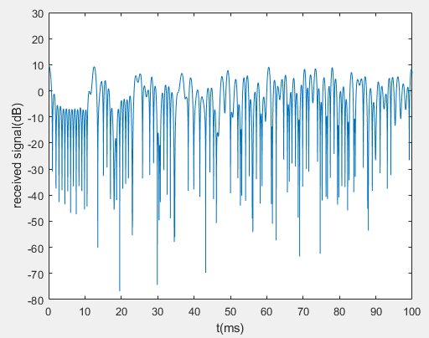
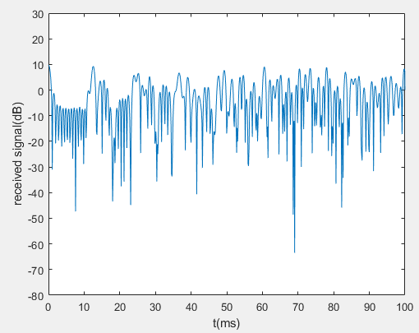


Estimated Channel magnitude
$$u_{1}의 값$$
$$u_{1}추정 값$$

Slide 12
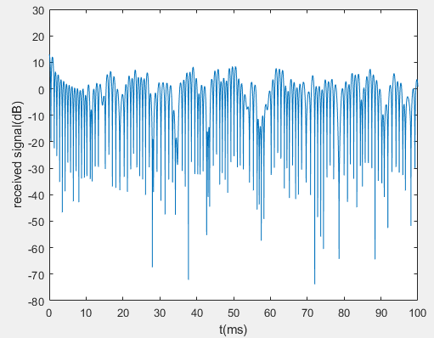
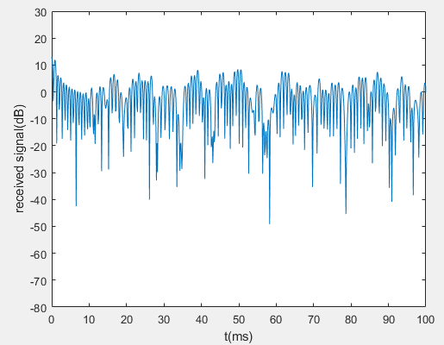


Estimated Channel magnitude
$$u_{2}의 값$$
$$u_{2}추정 값$$

